Slide 1
New Face Kaleidoscope of Amazone Redshift
Sergey D. Kuznetsov

Slide 2
Introduction (1)
Redshift was launched by Amazon Web Services in 2013
The first architectural solution was described in one well-known conference paper:
  Anurag Gupta, Deepak Agarwal, Derek Tan, Jakub Kulesza, Rahul Pathak, Stefano Stefani, Vidhya Srinivasan. Amazon Redshift and the Case for Simpler Data Warehouses. Proceedings of the 2015 ACM SIGMOD International Conference on Management of Data, May 2015, Pages 1917–1923
and one rather introductory book:
  Stefan Bauer. Getting Started with Amazon Redshift. Packt Publishing, 2013, 154 p.

Slide 3
Introduction (2)
Based on the first Redshift paper and some later documentation of Amason I prepared and presented last year some short architectural overview of Redshift within my talk
  Cloud Data Warehouses and Real-time Analytics
Certainly, Redshift was evolved in time, and new architectural solutions where described this year in new conference paper (with 24 authors!)
  Nikos Armenatzoglou, Sanuj Basu, Naga Bhanoori, Mengchu Cai, Naresh Chainani, Kiran Chinta, Venkatraman Govindaraju, Todd J. Green, Monish Gupta, Sebastian Hillig, Eric Hotinger, Yan Leshinksy, Jintian Liang, Michael McCreedy, Fabian Nagel, Ippokratis Pandis, Panos Parchas, Rahul Pathak, Orestis Polychroniou, Foyzur Rahman, Gaurav Saxena, Gokul Soundararajan, Sriram Subramanian, Doug Terry. Amazon Redshift Re-invented. Proceedings of the 2022 International Conference on Management of Data, June 2022, Pages 2205–2217

Slide 4
Introduction (3)
Moreover, last year Amazon people published a new book dedicated to Redshift that seems to be actual and more technical than the first one:
  Shruti Worlikar, Thiyagarajan Arumugam, Harshida Patel. Amazon Redshift Cookbook: Recipes for building modern data warehousing solutions. ‎ Packt Publishing, 2021, 384 p.
This talk is based on the information of the second paper and some technical documentation
We present new architectural and functional features of Redshift

Slide 5
Introduction (4)
Redshift’s developers are trying to satisfy following four main customer needs
To provide high-performance execution of increasingly complex analytical queries
To process more data and scale the number of users that derive insights from data
To make the system more easy to use
To provide seamless integration with the AWS ecosystem and other AWS purpose built services

Slide 6
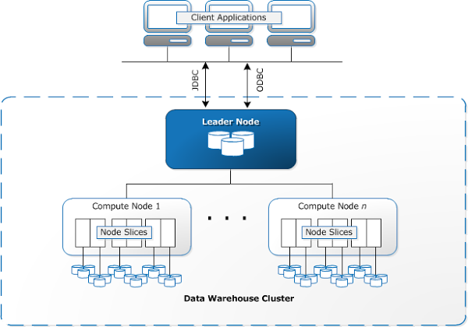
Initial Design of RedShift: Simple architecture
Based on PostgreSQL 8.0.2
Data are stored in columns, using specialized data compression encodings
Each Redshift cluster is composed of two
main components: Leader Node and Compute
Nodes
Leader Node is responsible for parsing the query and building an optimal execution plan for it to run
on the Compute Nodes, based on the portion
of data stored on each node
Based on the execution plan, the Leader Node creates compiled code and distributes it to the Compute Nodes for processing
Finally, the Leader Node receives and aggregates the results, and returns the results to the client application
Compute Node has its own dedicated CPU, memory, and disk storage
  Store data and execute queries and there may be many nodes in one cluster

Slide 7
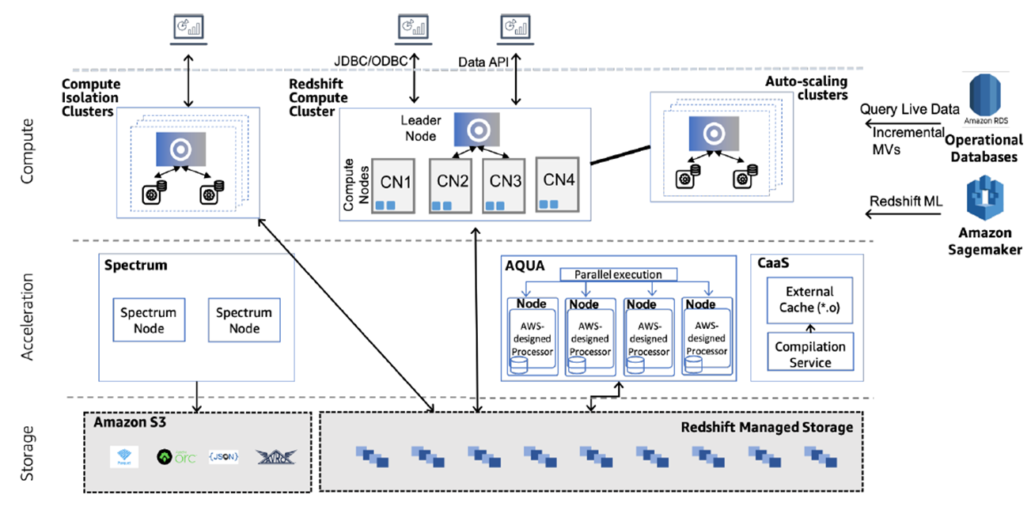
Modern General Architecture: Much More Complicated

Slide 8
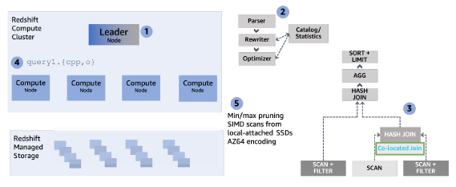
Performance – Query Execution (1)
The query is received by the
leader node (1) and subsequently
parsed, rewritten, and
optimized (2)
Redshift features a novel
Query Rewriting Framework (QRF – no references), which serves
multiple purposes
First, it enables rapid introduction of novel rewritings and optimizations
  In particular, QRF has been used to introduce rewriting rules that optimize the order of execution between unions, joins and aggregations
  It is used also during query decorrelation (joins instead subqueries)

Slide 9
Performance – Query Execution (2)
Second, QRF is used for creating
scripts for incremental
materialized view maintenance
and enabling answering queries
using materialized views
Redshift’s cost-based optimizer
includes the cluster’s topology and the cost of data movement between compute nodes in its cost model to select an optimal plan
Planning leverages the underlying distribution keys of participating tables to avoid unnecessary data movement
  For instance, if the join key in an equi-join matches the underlying distribution keys of both participating tables, then the chosen plan avoids any data movement by processing the join locally for each data partition (3)

Slide 10
Performance – Query Execution (3)
Next, the optimized plan is
divided into individual execution
units that either end with a
blocking pipeline-breaking
operation or return the final result
to the user
These units are executed in sequence, each consuming intermediate results of previously executed units
For each unit, Redshift generates highly optimized C++ code that interleaves multiple query operators in a pipeline using one or more (nested) loops, compiles it and ships the binary to compute nodes (4)

Slide 11
Performance – Query Execution (4)
The main property of using
style of code generation is that
it avoids any type of interpreted
code since all operators for a
specific query are generated in
the code on the fly
When a query is sent to Redshift, the query processing engine compiles
optimized object files that are used for query execution
When the same or similar queries are executed, the compiled segments
are reused from the cluster code compilation cache, which results in
faster run times because there is no compilation overhead.

Slide 12
Performance – Query Execution (5)
The compilation service uses
compute and memory resources
beyond the Redshift cluster to
accelerate query compilation
through a scalable and secure
architecture
The compilation service caches
the compiled objects off-cluster in an external code cache to serve multiple compute clusters that may need the same query segment
During query processing, Redshift generates query segments and leverages the parallelism of the external compilation service for any segments that are not present in a cluster’s local cache or the external code cache

Slide 13
Performance – Query Execution (6)
Redshift added a SIMD-
vectorized scan layer to the
generated code that accesses
the data blocks and evaluates
predicates as function calls
In contrast to the rest of the steps that compile the code on the fly, the vectorized scan functions are precompiled and cover all data types and their supported encoding and compression schemes
The output of this layer stores the column values of the tuples that qualify from the predicates to local arrays on the stack accessed by downstream steps

Slide 14
Performance – Query Execution (7)
The columnar data are scanned
from locally attached SSDs or
hydrated from Redshift
Managed Storage (5)
If the execution unit requires
exchanging data with other
compute nodes over the network, then the execution unit consists of multiple generated binaries that exchange data in a pipelined fashion over the network
Redshift’s execution engine employs numerous optimizations to improve query performance
To reduce the number of blocks that need to be scanned, Redshift evaluates query predicates over zone maps i.e., small hash tables that contain the min/max values per block and leverages late materialization

Slide 15
Performance – Query Execution (8)
The data that needs to be scanned
after zone-map filtering is
chopped into shared work units,
to allow for balanced parallel
execution
Scans leverage vectorization and
SIMD processing for fast decompression of Redshift’s light-
weight compression formats and for applying predicates efficiently
Bloom filters, created when building hash tables, are applied in the scan to further reduce the data volume that has to be processed by downstream query operators
Prefetching is leveraged to utilize hash tables more efficiently

Slide 16
Performance – Query Execution (9)
Advanced Query Accelerator (AQUA) is
a multi-tenant service that acts as an
off-cluster caching layer for Redshift
Managed Storage and a push-down
accelerator for complex scans and
aggregations
AQUA caches hot data for clusters on local SSDs,
avoiding the latency of pulling data from a
regional service like Amazon S3 and reducing the
need to hydrate the cache storage in Redshift compute nodes
To avoid introducing a network bottleneck, the service provides a functional interface, not a storage interface
Redshift identifies applicable scan and aggregation operations and pushes them to AQUA, which processes them against the cached data and returns the results
Essentially, AQUA is computational storage at a data-center scale

Slide 17
Performance – Query Execution (10)
Redshift’s execution engine
takes runtime decisions to
boost performance by changing
the generated code or
runtime properties on the fly
based on execution statistics
For instance, the implementation of Bloom filters (BFs) in Redshift demonstrates the importance of dynamic optimizations
For example, if a join spills data to disk, then the join operator can decide to build a larger BF to achieve lower false-positive rates
The execution engine can re-enable a BF periodically since temporal
pattern of data may render a previously ineffective BF to become
effective

Slide 18
Scaling: Storage (1)
The storage layer of Amazon Redshift spans from memory, to local storage, to cloud object storage (Amazon S3) and encompasses all the data lifecycle operations (i.e., commit, caching, prefetching, snapshot/restore, replication, and disaster-recovery).
The storage layer ensures durability, availability, scalability, and performance:
Durability and Availability: The storage layer builds on Amazon S3 and persists all data to Amazon S3 with every commit
This allows Redshift to decouple data from the compute cluster that operates on the data
It also makes the data durable and building an architecture on top of it enhances availability
Scalability: Using Amazon S3 as the base gives virtually unlimited scale
Redshift Managed Storage (RMS) takes advantage of optimizations such as data block temperature, data block age, and workload patterns to optimize performance and manage data placement across tiers of storage automatically.
Performance: Storage layer extends into memory and algorithmic optimizations
It dynamically prefetches and sizes the in-memory cache, and optimizes the commit protocol to be incremental

Slide 19
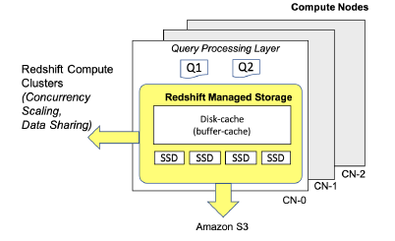
Scaling: Storage (2)
RMS builds on top of the AWS Nitro
System, which features high bandwidth
networking and performance
“The AWS Nitro System is a new virtualization
infrastructure that serves as the underlying platform
for the next generation of EC2 instances”
  https://www.virtana.com/glossary/what-is-aws-nitro/
RMS manages both user data as well as transaction metadata
Compute nodes use large, high performance SSDs as local caches
Redshift leverages workload patterns and techniques such as automatic fine-grained data eviction and intelligent data prefetching, to deliver the performance of local SSD while scaling storage automatically to Amazon S3

Slide 20
Scaling: Storage (3)
RMS tunes cache replacement to keep the
relevant blocks locally available by
tracking accesses to every block
This information is also used to help
customers decide if scaling up their
cluster would be beneficial
RMS makes in-place cluster resizing a pure metadata operation since compute nodes are practically stateless and always have access to the data blocks in RMS
RMS is metadata bound and easy to scale since data can be ingested directly into Amazon S3
The in-memory disk-cache size can be dynamically changed for balancing
performance and memory needs of queries

Slide 21
Scaling: Storage (4)
Decoupling metadata from data enables
Elastic Resize and Cross-Instance Restore
Both features shuffle metadata from one
cluster configuration to another and
thus separating metadata from data can
lead to an efficient implementation
Elastic Resize allows customers to reconfigure their cluster in minutes by adding nodes to get better performance and more storage for demanding workloads or by removing nodes to save cost
Cross-Instance Restore allows users to restore snapshots taken from a
cluster of one instance type to a cluster of different instance type or different number of nodes

Slide 22
Scaling: Storage (5)
Redshift enhances scalability by using
Amazon S3 to expand storage capacity
of a cluster and utilizing the local
memory and SSD as caches
The tiered-storage cache keeps track of the number of
accesses of data blocks so that each cluster maintains its working set locally
It builds a two-level clock-based cache replacement
policy to track data blocks stored in local disk for each compute node
Cache policy places a cold data block 𝐵 (i.e., accessed for the first time by customer query) in the low-level clock cache and increases 𝐵’s reference count on every access
When 𝐵 becomes hot (i.e., accessed multiple times), cache policy promotes it to the high-level clock cache
During eviction, the reference count of each block pointed by clock pointer is decremented
When the reference count of 𝐵 is zero, 𝐵 is either demoted from high-level clock to low-level
clock or evicted from the cache.

Slide 23
Scaling: Storage (6)
RMS uses the tiered-storage cache to
drive rehydration (i.e., what data to
cache on local SSDs) after a cluster
reconfiguration (e.g., Elastic Resize)
In all these scenarios, the compute nodes rehydrate their local disks with the data blocks that have highest possibility to be accessed by customer queries
With this optimization, customer’s queries achieve more than 80% local disk hit rate at 20% rehydration completion

Slide 24
Scaling: Storage (7)
To boost performance, Redshift utilizes
a dynamic disk cache on top of
tiered-storage cache to maintain the
hottest blocks in memory
In addition, the disk-cache keeps other
blocks created by queries such as new data blocks and query-specific temporary blocks
Disk-cache automatically scales up when memory is available and proactively scales down as the system is near memory exhaustion
These changes lead up to a 30% performance improvement in benchmarks as well as customer workloads

Slide 25
Scaling: Compute (1)
Cluster Size Scaling: Elastic Resize allows customers to quickly add or remove compute nodes from their cluster depending on their current compute needs
Elastic Resize re-organizes the data partition assignment to ensure that after the resize, all compute nodes are balanced with respect to the number of data partitions
After the resize, the data partitions that have been moved are re-hydrated from S3 in the background; prioritizing on-demand requests and hot data
When there is more compute parallelism than data partitions, multiple compute processes are able to share work from an individual data partition
When there are more data partitions than compute parallelism, individual compute processes are able to work on multiple data partitions

Slide 26
Scaling: Compute (2)
Concurrency Scaling allows Redshift to dynamically scale-out when users need more concurrency than what a single Redshift cluster can offer
As the number of concurrent queries increases, Concurrency Scaling transparently handles the increase in the workload
With Concurrency Scaling customers maintain a single cluster endpoint to which they submit their queries
When the assigned compute resources are fully utilized and new queries start queuing, Redshift automatically attaches additional Concurrency Scaling compute clusters and routes the queued queries to them
Concurrency Scaling clusters re-hydrate data from RMS

Slide 27
Easy to Use: Automated Tuning and Operations (1)
As the title of the first Redshift paper indicates, from the early days, Redshift simplified many aspects of traditional data warehousing, including cluster maintenance, patching, monitoring, resize, backups and encryption
However, there were still some routine maintenance tasks and performance knobs whose fine-tuning required the expertise of a database administrator
For instance, customers had to schedule maintenance tasks (e.g., vacuum) and decide on performance parameters such as distribution keys
To alleviate this pain, Redshift invested heavily in maintenance automation and machine learning based autonomics

Slide 28
Easy to Use: Automated Tuning and Operations (2)
Today, Redshift runs common maintenance tasks like vacuum, analyze or the refresh of materialized views in the background without any performance impact to customer workloads
Automatic workload management dynamically chooses query concurrency and memory assignment based on workload characteristics
Furthermore, Redshift monitors and analyzes customer workloads and identifies opportunities for performance improvement, e.g., by automatically applying distribution and sort key recommendations

Slide 29
Easy to Use: Automated Tuning and Operations (3)
In addition, Redshift employs state of the art forecasting techniques to make additional nodes available as soon as possible for node failures, cluster resumption and concurrency scaling, thus, further improving query latency and reducing down time
Finally, Amazon Redshift offers a serverless option that relies on algorithms and makes it easy to run and scale analytics in seconds without the need to set up and manage data warehouse infrastructure
We will discuss in some details only two points: Query Predictor and Materialized Views

Slide 30
Easy to Use: Automated Tuning and Operations (4)
Query Predictor Framework: Redshift supports learning models to predict the memory consumption and the execution time of a query
The Query Predictor Framework runs within each Redshift cluster, collects training data, trains an XGBOOST model and permits inference whenever required
  XGBoost (eXtreme Gradient Boosting) is an open-source software library which provides a regularizing gradient boosting framework (Wiki)
This allows Redshift to learn from the workload and selftune accordingly to improve performance
  Having a predictor on the cluster itself helps to quickly react to changing workloads
Code compilation sub-system also makes use of the query predictor framework to improve the overall query response time

Slide 31
Easy to Use: Automated Tuning and Operations (5)
Materialized Views are especially useful for speeding up queries that are predictable and repeated
Redshift automates the efficient maintenance and use of MVs in three ways
(1) It incrementally maintains filter, projection, grouping and join in materialized views to reflect changes on base tables
  Since Redshift thrives on batch operations, MVs are maintained in a deferred fashion, so that the transactional workload is not slowed down

Slide 32
Easy to Use: Automated Tuning and Operations (6)
(2) Redshift can automate the timing of the maintenance
In particular, Redshift detects which MVs are outdated and maintains a priority queue to choose which MVs to maintain in the background.
The prioritization of refreshes is based on combining
  (a) the utility of a materialized view in the query workload and
  (b) the cost of refreshing the materialized view
The goal is to maximize the overall performance benefit of materialized views
For 95% of MVs, Redshift brings the views up-to-date within 15 minutes of a base table change.

Slide 33
Easy to Use: Automated Tuning and Operations (7)
(3) Redshift users can directly query an MV but they can also rely on Redshift’s sophisticated MV-based autorewriting to rewrite queries over base tables to use the best eligible materialized views to optimally answer the query
MV-based autorewriting is cost based and proceeds only if the rewritten query is estimated to be faster than the original query

Slide 34
Integration: Using The Best Tool for the Job (1)
AWS offers multiple purpose-built services, i.e., services that excel in their objective
These purpose-built services include
  the scalable object storage service Amazon S3,
  transactional database services (e.g., DynamoDB and Aurora), and
  the ML services of Amazon Sagemaker
AWS and Redshift make it easy for their users to use the best service for each job and seamlessly integrate with Redshift.

Slide 35
Integration: Using The Best Tool for the Job (2)
Open file formats: In addition to the data in RMS, Redshift also has the ability to access data in open file formats in Amazon S3 via a feature called Spectrum
  Mengchu Cai, Martin Grund, Anurag Gupta, Fabian Nagel
  Ippokratis Pandis, Yannis Papakonstantinou, Michalis Petropoulos. Integrated Querying of SQL database data and S3 data in Amazon Redshif. Bulletin of the IEEE Computer Society Technical Committee on Data Engineering, vol. 41, no. 2, 2018, pp. 82-90
Redshift Spectrum facilitates exabyte scale analytics of data lakes and is extremely cost effective with pay-as-you-go billing based on amount of data scanned
Spectrum provides massive scale-out processing, performing scans and aggregations of data in Parquet, Text, ORC and AVRO formats
  Apache Parquet is a free and open-source column-oriented data storage format for the Apache Hadoop ecosystem
  Apache Optimized Row Columnar (ORC) file format is a self-describing, type-aware columnar file format designed for Hadoop ecosystem workloads
  Apache Avro is a compact, fast, binary data format (non-human readable)

Slide 36
Integration: Using The Best Tool for the Job (3)
In order to leverage Spectrum, Redshift customers register their external tables in either Hive Metastore, AWS Glue or AWS Lake Formation catalog
  Hive metastore (HMS) is a service that stores metadata related to Apache Hive and other services, in a backend RDBMS, such as MySQL or PostgreSQL
  AWS Glue is a serverless data integration service that makes data preparation simpler, faster, and cheaper
  AWS Lake Formation is a service that makes it easy to set up a secure data lake in days
During query planning, Spectrum tables are localized into temporary tables to internally represent the external table
Subsequently, queries are rewritten and isolated to Spectrum sub-queries in order to pushdown filters and aggregation

Slide 37
Integration: Using The Best Tool for the Job (3)
Redshift ML makes it easy for data analysts to train machine learning models and perform prediction (inference) using SQL
Internally, Redshift ML uses Amazon SageMaker, a fully managed machine learning service
  Garry Kranz. Amazon SageMaker. https://www.techtarget.com/searchaws/definition/Amazon-SageMaker
After a model has been trained, Redshift makes available a SQL function that performs inference and can be used directly in SQL queries

Slide 38
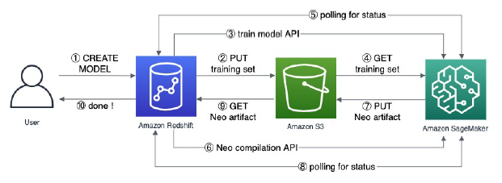
Integration: Using The Best Tool for the Job (4)
When a customer initializes the
process, Redshift ML uses sampling
to unload the proper amount of
data from the Redshift cluster to
an S3 folder
Subsequently, in the Redshift AUTO training
mode, a Sagemaker Autopilot job is initiated
under-the-hood
It discovers the best combination of preprocessor, model and hyperparameters
In order to perform ML inference locally using this model, Redshift invokes the Amazon Sagemaker Neo service to compile the model
Neo transforms the classic machine learning models from the Scikit-Learn library into inference code
  Scikit-Learn, also known as Sklearn, is a free, open-source ML library used for the Python language
Thus, the user obtains the benefits of the purpose-built ML tools, while staying in Redshift

Slide 39
Integration: Using The Best Tool for the Job (5)
AWS offers purpose-built OLTP-oriented database services, such as DynamoDB, Aurora Postgres, and Aurora MySQL
  Giuseppe DeCandia, Deniz Hastorun, Madan Jampani, Gunavardhan Kakulapati, Avinash Lakshman, Alex Pilchin, Swaminathan Sivasubramanian, Peter Vosshall, and Werner Vogels. Dynamo: Amazon’s Highly Available Key-value Store. ACM SIGOPS Operating Systems Review, Volume 41, Issue 6, December 2007, pp. 205–220
  Alexandre Verbitski, Anurag Gupta, Debanjan Saha, Murali Brahmadesam, Kamal Gupta, Raman Mittal, Sailesh Krishnamurthy, Sandor Maurice, Tengiz Kharatishvili, Xiaofeng Bao. Amazon Aurora: Design considerations for high throughput cloud-native relational databases. Proceedings of the 2017 ACM International Conference on Management of Data, May 2017, Pages 1041–1052
Redshift facilitates both the in-place querying of data found in the OLTP services, using Redshift’s Federated Query, as well as the seamless copying and synchronization of data to Redshift, using Glue Elastic Views

Slide 40
Integration: Using The Best Tool for the Job (6)
Redshift Federated Query supports direct connections to the customer’s Postgres or MySQL instances and fetches live data
This enables real-time reporting and analysis and simplified ETL processing, without the need to extract data from the OLTP service to Amazon S3 and load it afterwards
The ability to access both Redshift tables and Postgres or MySQL tables in a single query is effective allowing users to have a fresh "union all" view of their data
In addition, Redshift Federated Query includes a query optimization component to determine the most efficient way to execute a federated query, sending subqueries with filters and aggregations into the OLTP source database to speed up query performance and reduce data transfer over the network

Slide 41
Integration: Using The Best Tool for the Job (7)
The integration of Glue Elastic Views (GEV) with Redshift facilitates and accelerates the ingestion of data from OLTP sources into Redshift
GEV enables the definition of views over AWS sources (starting with DynamoDB, with additional sources to be added later)
The views are defined in PartiQL, a language backwards compatible with SQL, which can operate on both schemaful and schemaless sources
GEV offers a journal of changes to the view, i.e., a stream of insert and delete changes
Consequently, the user can define Redshift materialized views that reflect the data of the GEV views; that is, Redshift materialized views that upon refresh, consume the stream of inserts and deletes received from the journal

Slide 42
Conclusion
The discussed paper provides a lot of interesting data about current state of Amazon Redshift
However, it is not easy estimate a quality of described features due very restricted information available
Often, a short piece of text in the paper is the only available source of information
I think it would be better for research community (and for AWS too) if people from the Redshift team to write and publish more articles with more detailed description of their research and development

